Slide 1
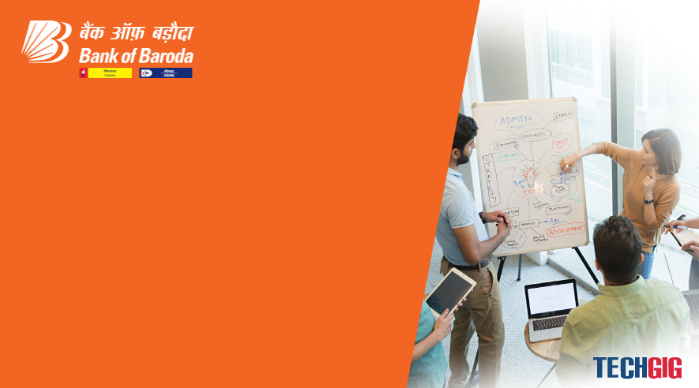

Bank of Baroda Hackathon - 2022
Technology Partner
Your Team Name : TWO isto TWO
Your team bio : B.Tech Artificial Intelligence
And Data Science
Date :19/9/2022

Slide 2
Problem Statement?
Why did you decide to solve this Problem statement?
In various competitions ,we are seeing about various
types of problems , but here it was different from other i.e, involved with bank.

Slide 3
User Segment & Pain Points
Which user /advertiser segment would be early adopter of your product & why?
It can be taken by any bank and customer of bank ,because it make our work easy and simple.

Slide 4
Pre-Requisite
What are the alternatives/competitive products for the problem you are solving?
The alternative product of this product is currently used in the banks which is nothing but CTS ( Cheque Truncation system ).

Slide 5
Azure tools or resources
Azure tools or resources which are likely to be used by you for the prototype, if your idea gets selected
Here we use just with mobile phone and Camera , It just work with a mobile phone

Slide 6
Any Supporting Functional Documents
Present your solution, talk about methodology, architecture & scalability
A simple mobile which scans the image of the cheque and
sends it to the paying bank.
Here we use AI Technology ie, OCR (Optical Charecter
Recognisation)
Here we use separate OCR algorithms for detecting name,
acc. no, MICR no, amount, etc.
THe user can use it any where at any time and place.
The payer also recives a requesst to further proceed the
process.

Slide 7
Key Differentiators & Adoption Plan
How is your solution better than alternatives and how do you plan to build adoption?
Now in this system the payee should reach the bank for deposting it.
With this app the user can take it from the any place.

Slide 8
GitHub Repository Link & supporting diagrams, screenshots, if any
How far it can go?
It can be used as long as there is a mobile phone with a camera avilable.

Slide 9
Thank You
Team member names

